Slide 1

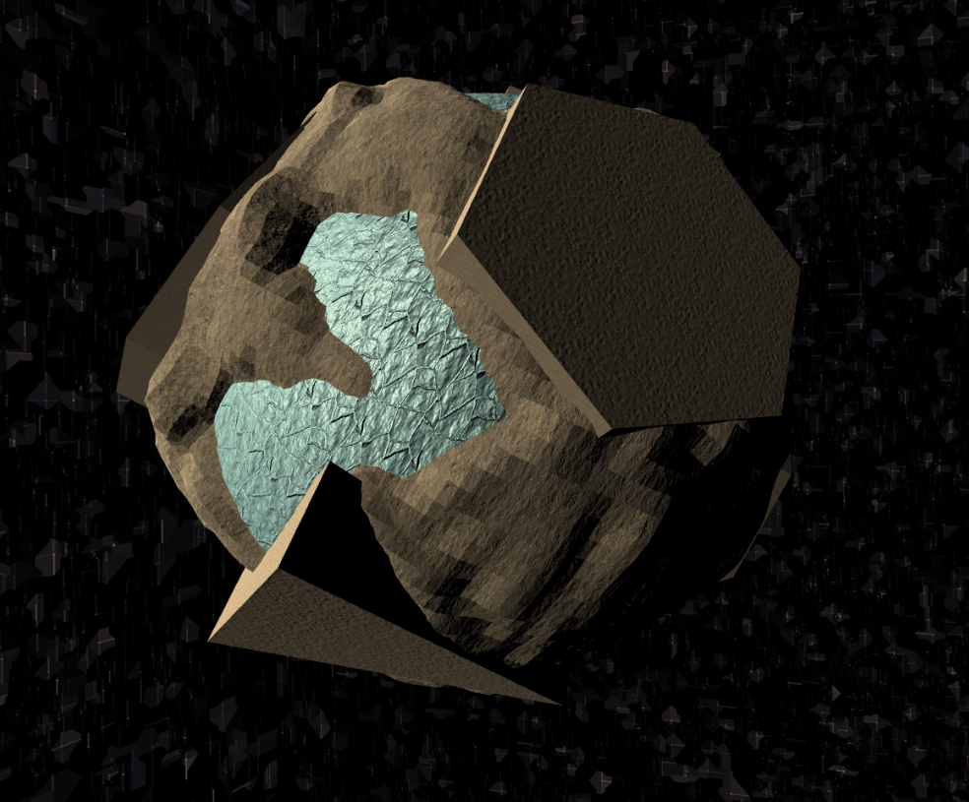
3D Breakout game upgrade
Mustafa Candan 21627059

Slide 2
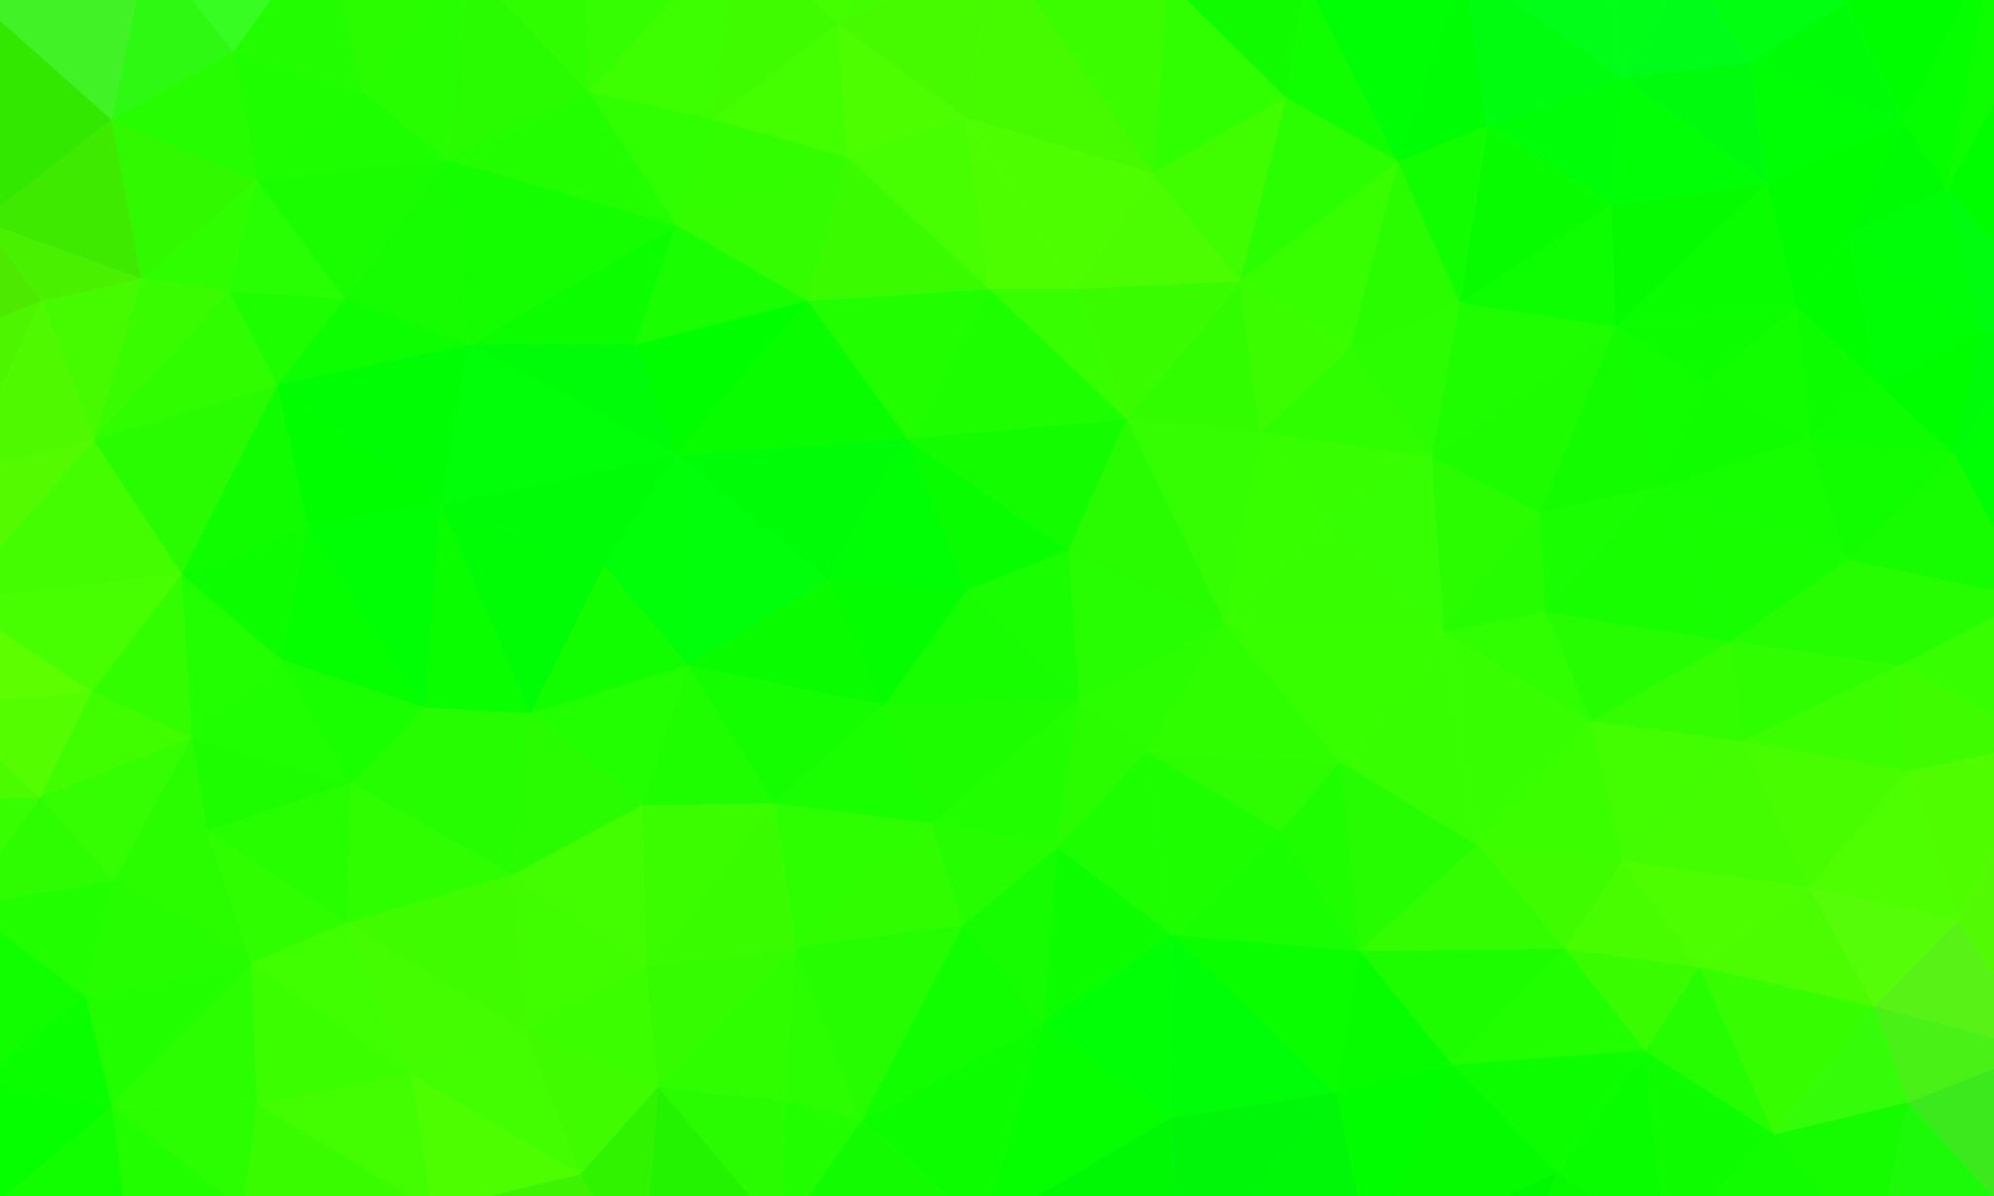
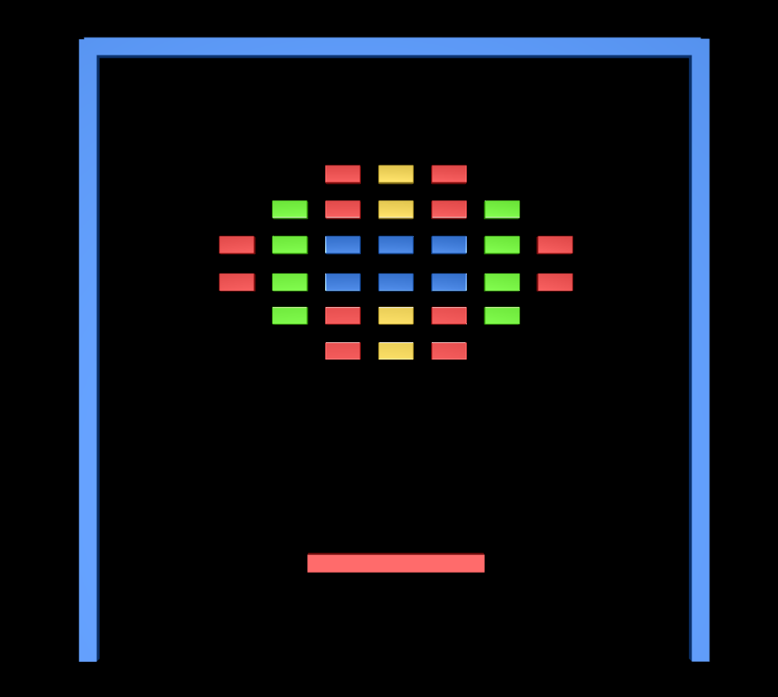
What was Gıven
I have gıven an project that has
Sıngle level
Themeless
Non Bouncable Cubes
Basıc UI

Slide 3
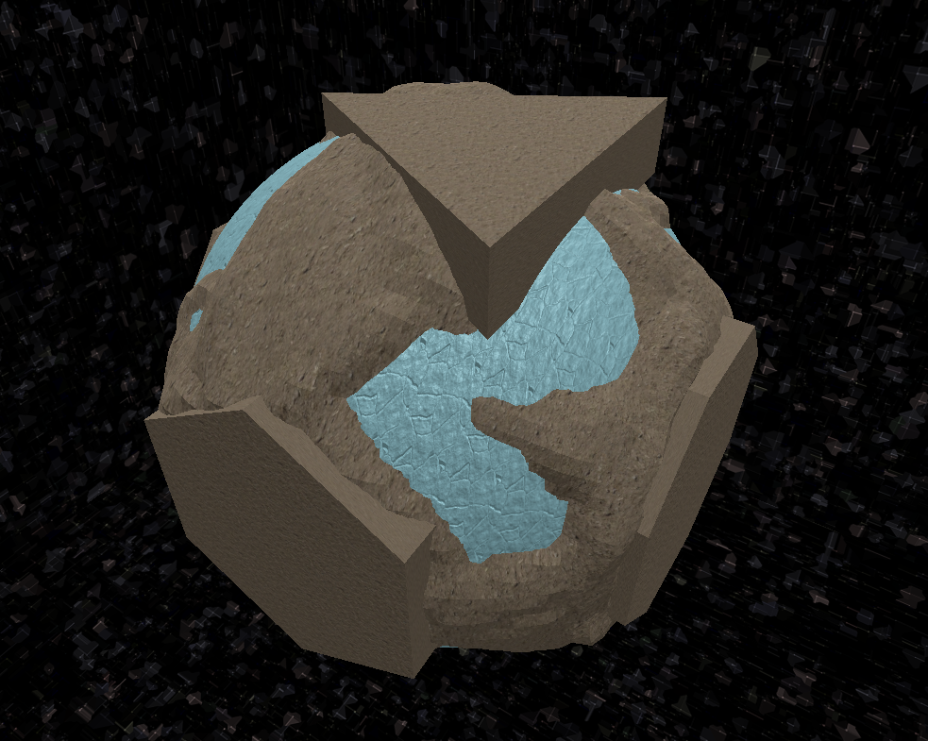
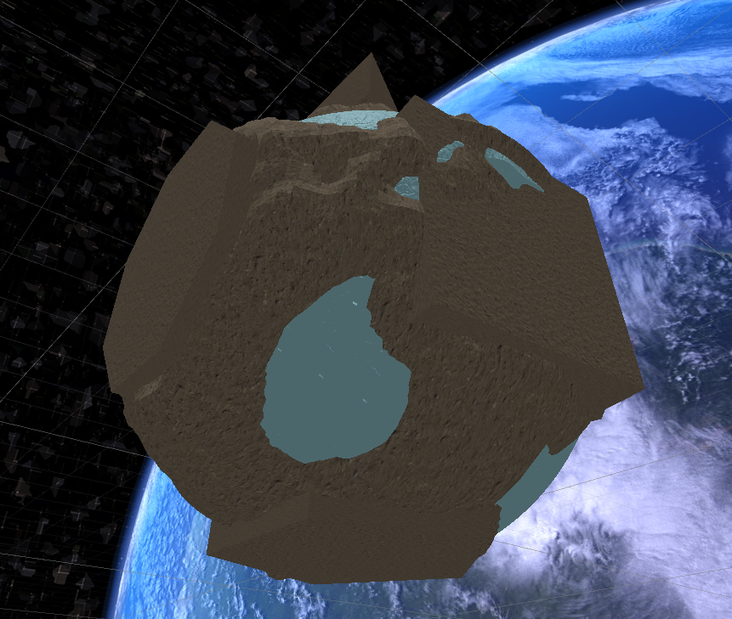
How dıd ı started
I started with creating a theme for game that took place in space.
First approach was create planet for shape levels.
So I created this planet model which has 6 faces and 6 different shapes for Levels.

Slide 4
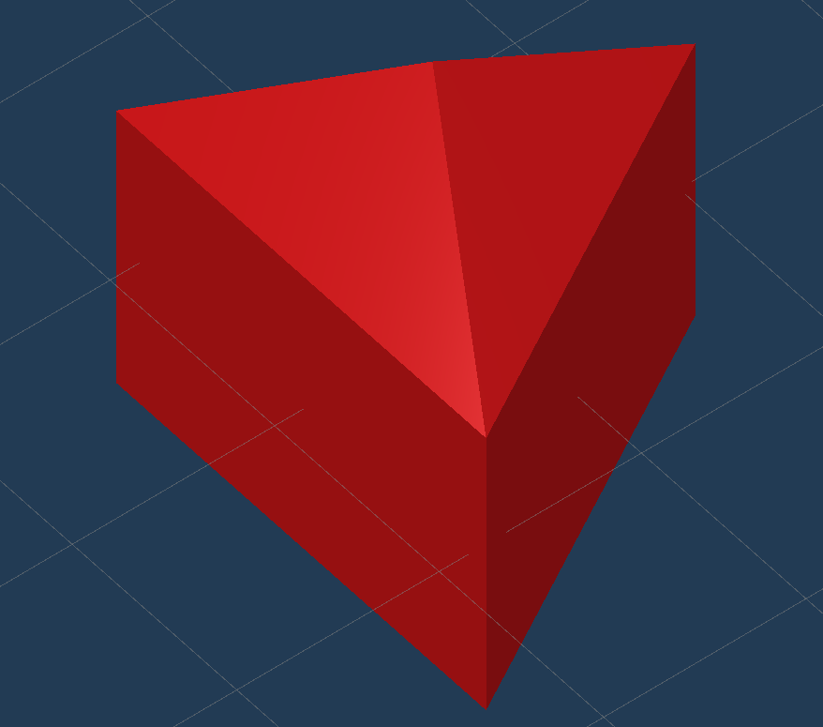
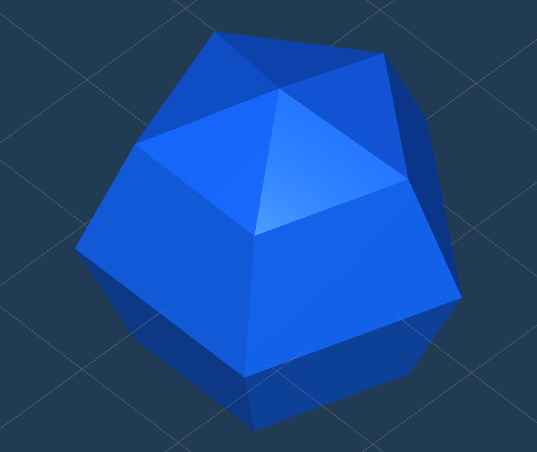
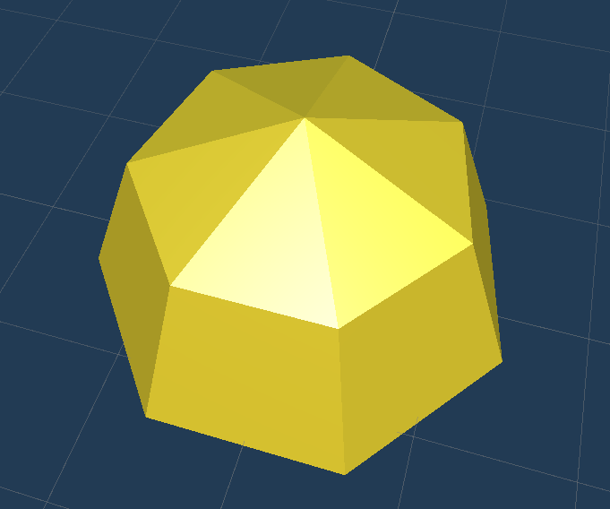
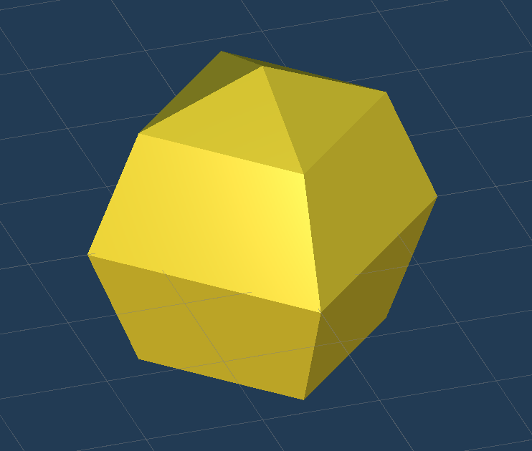
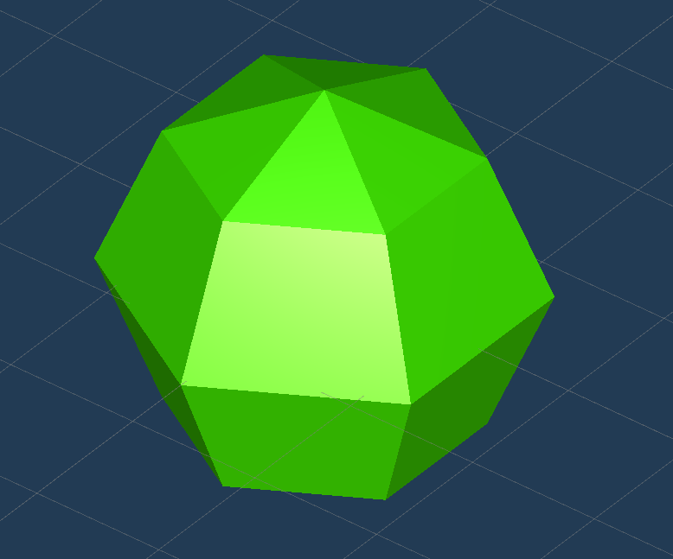
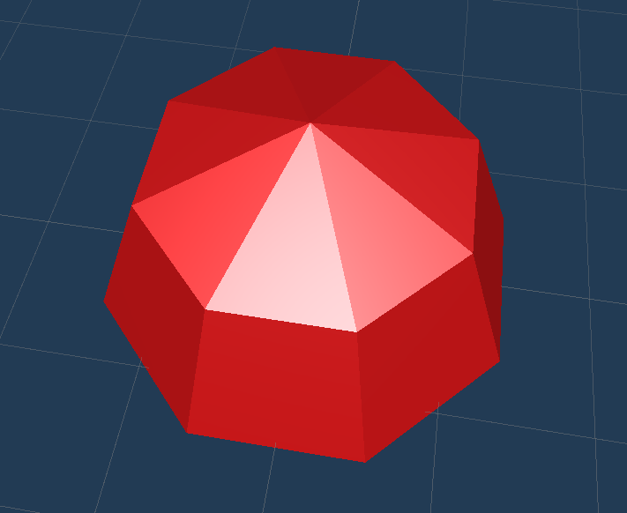
SHapes
Dıfferent shaped playgrounds needs dıfferent shaped Destroyable object
So ı created them wıth usıng Blender

Slide 5
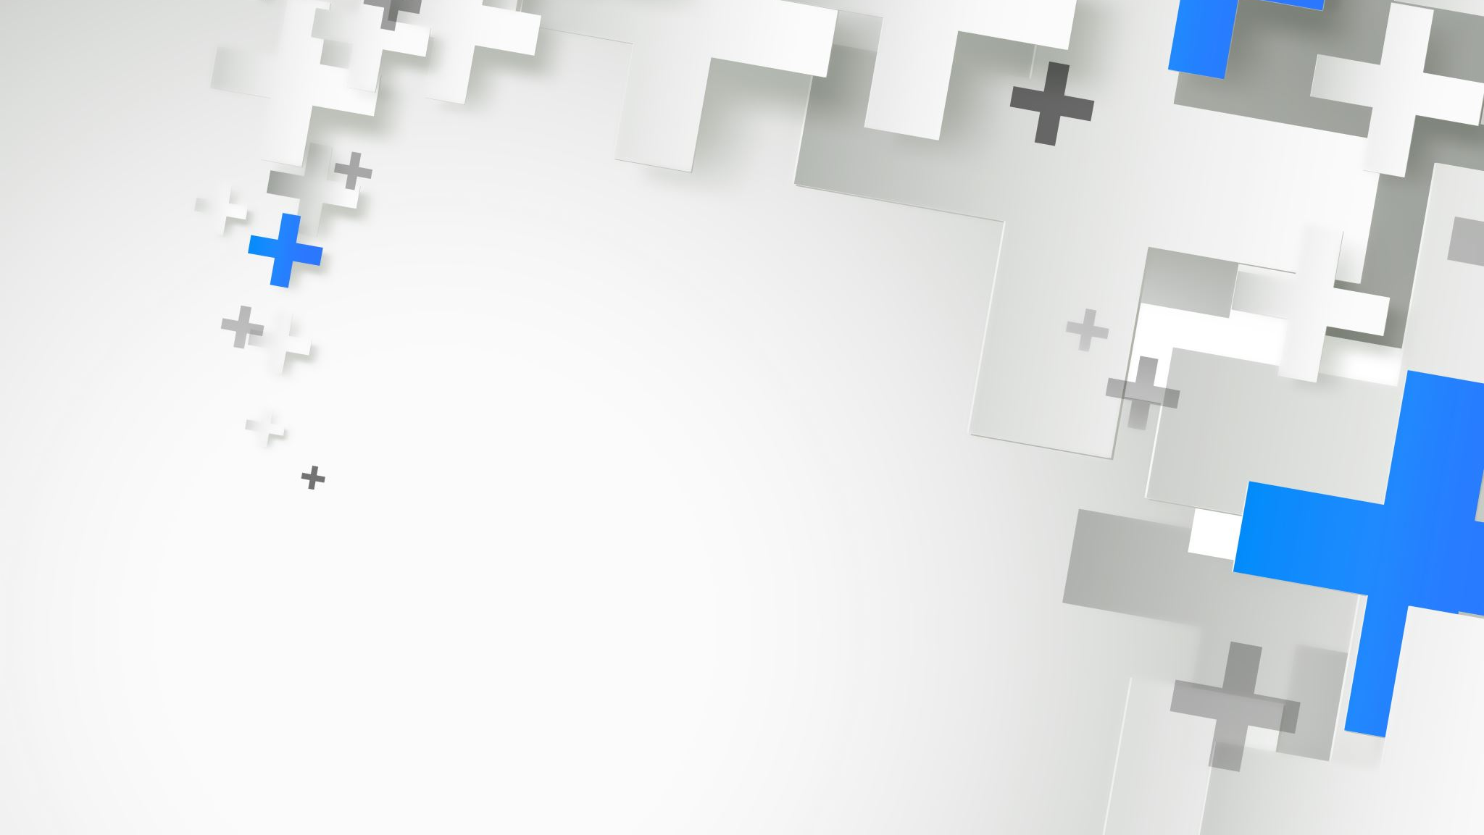
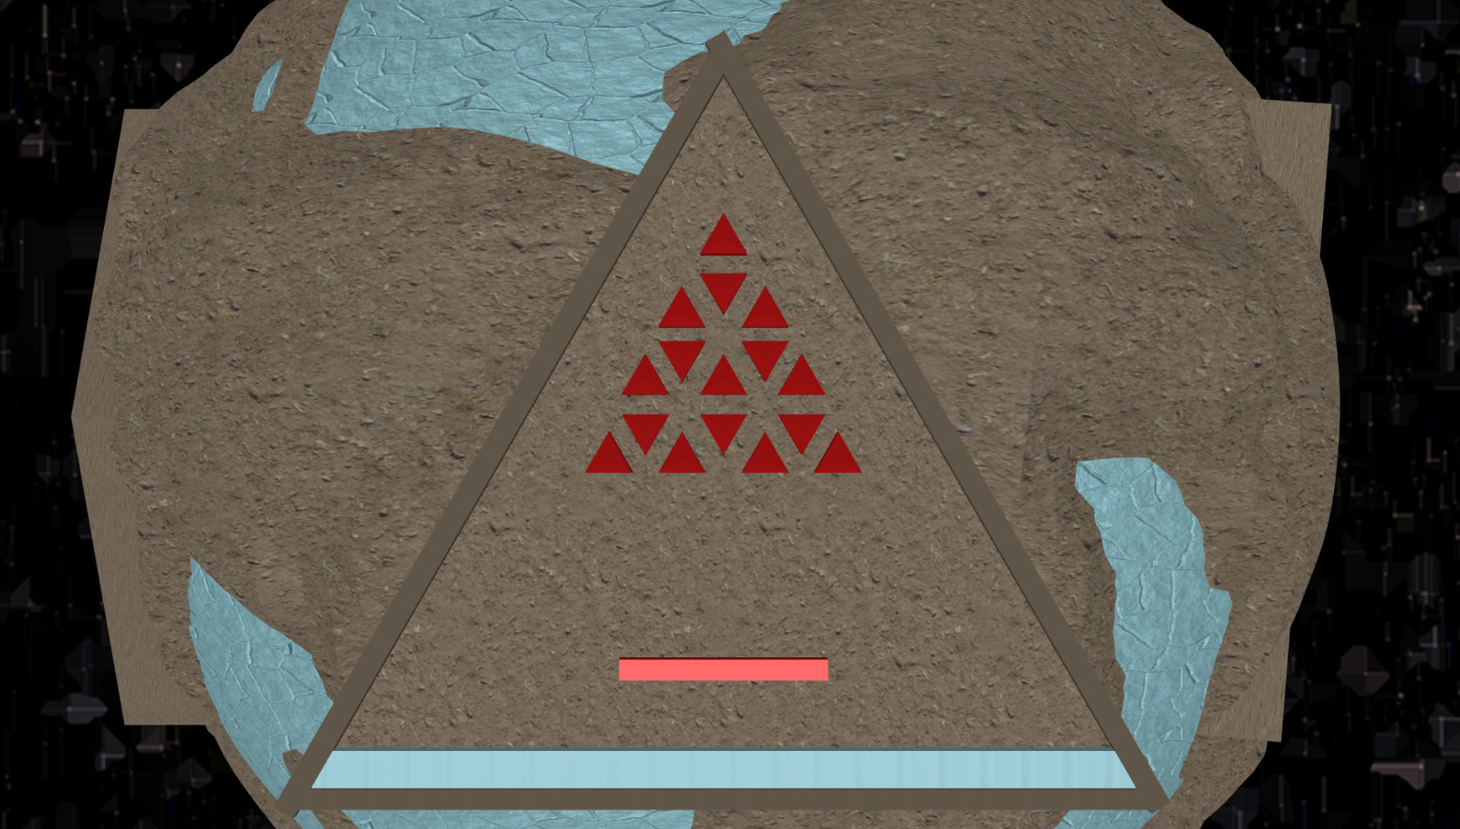
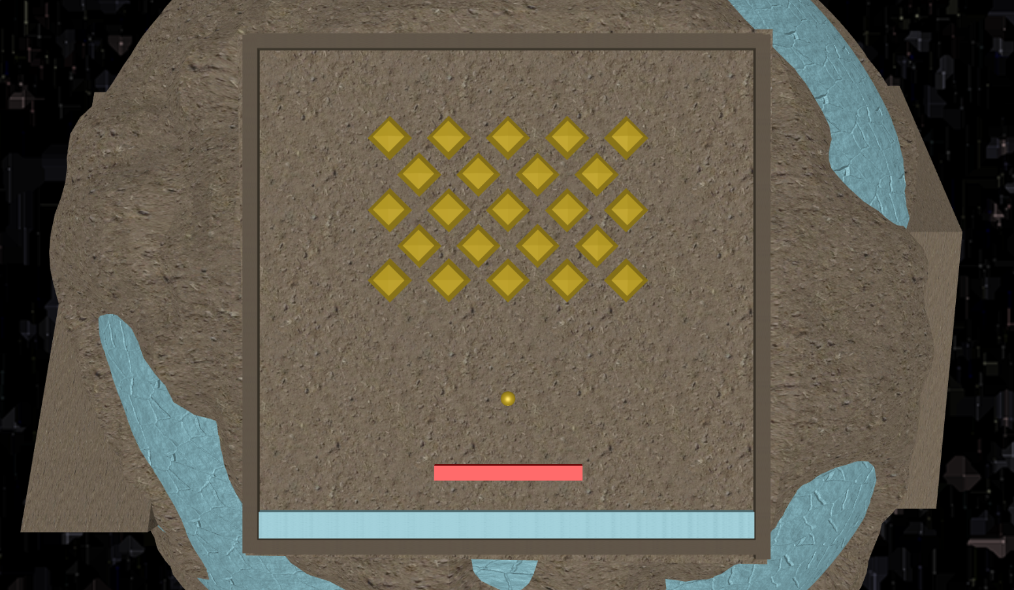
When we combıne these two we wıll get thıs

Slide 6
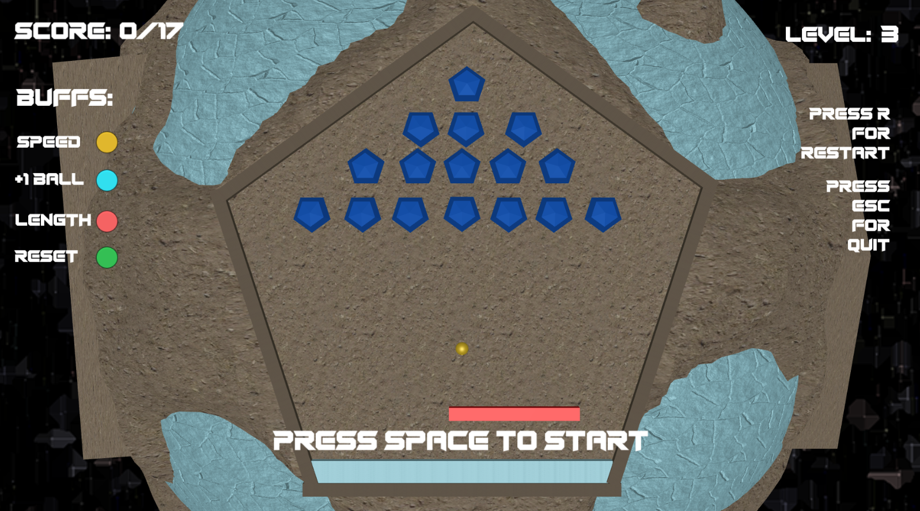
Stats needs to be seen UI

Slide 7
Best way of feedback:
To give best experience to the player, I added background music and sound effects for ;
Bouncing
Getting Buffs
Destroying Objects
Wining the level
Losing the level
Sound

Slide 8
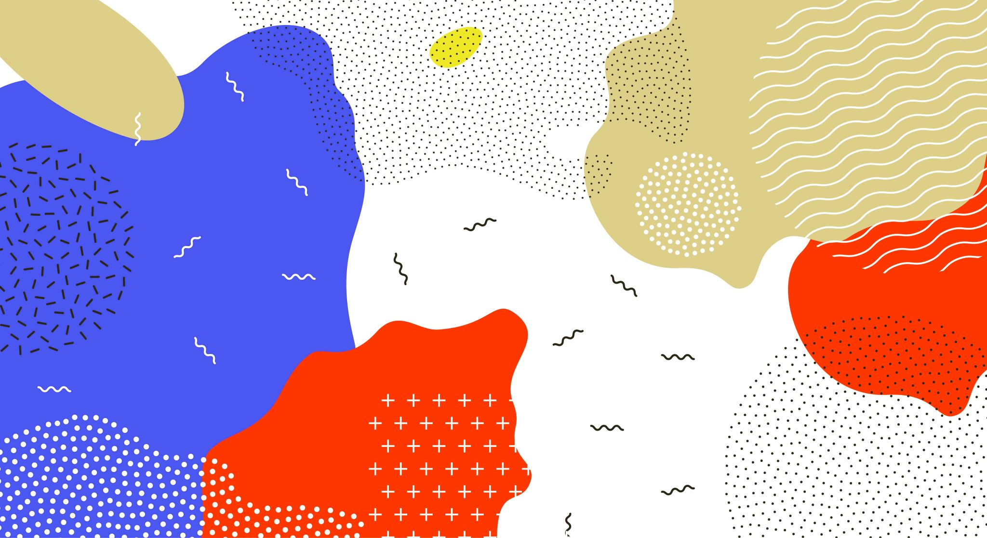
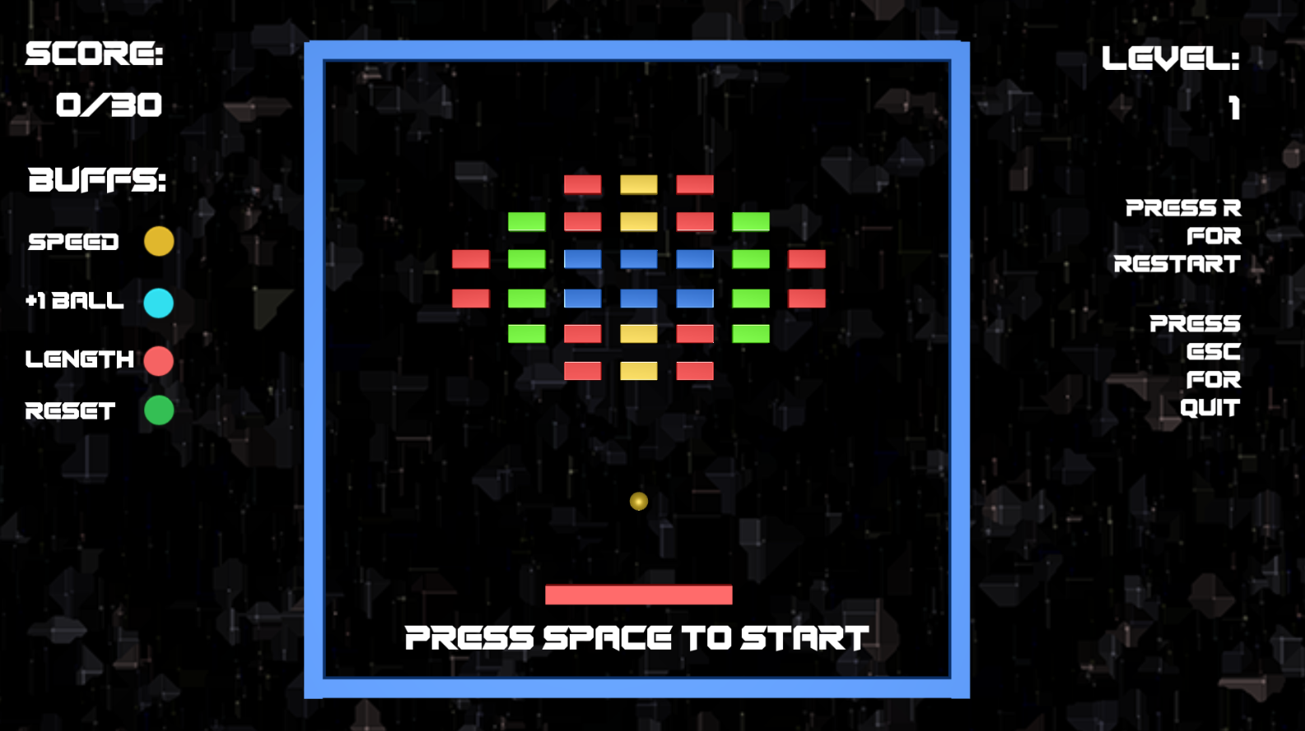
After what?
After creatıng my approach for the game ,
ı wanted to create orıgınal breakout game .
So I created orıgınal game’s mechanıcs and levels
Whıch has bouncble Cubes
And ofcourse Buffs

Slide 9
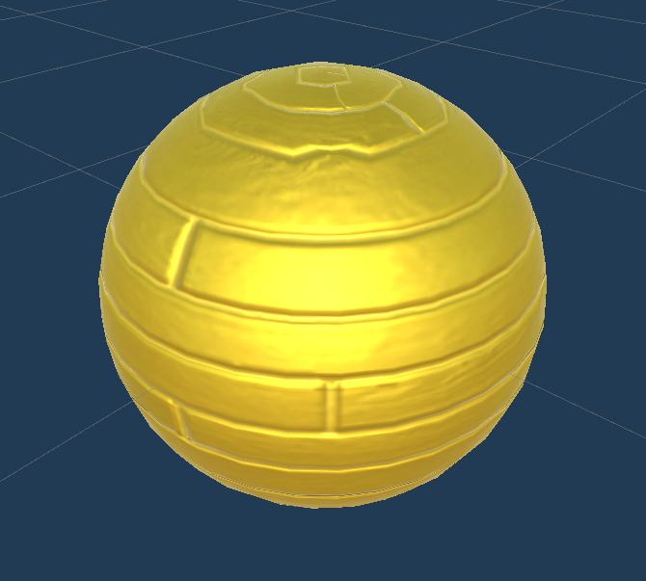
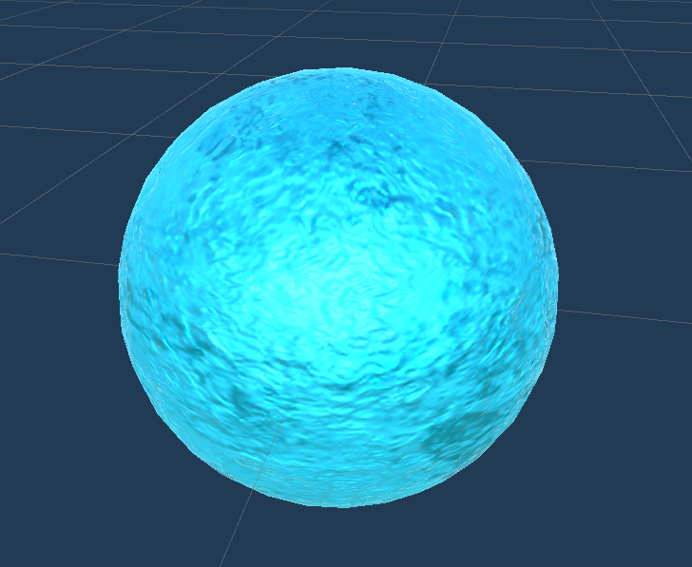
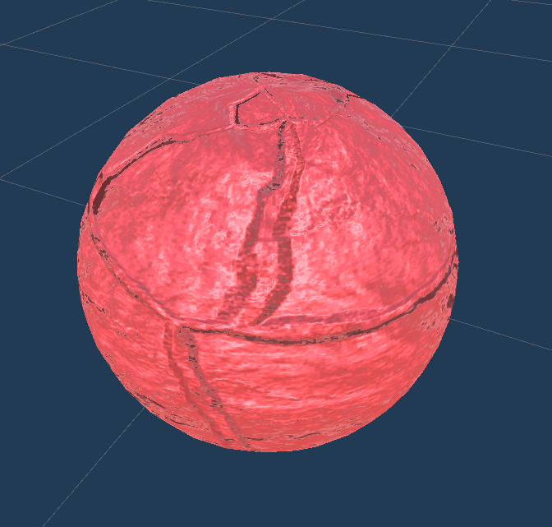
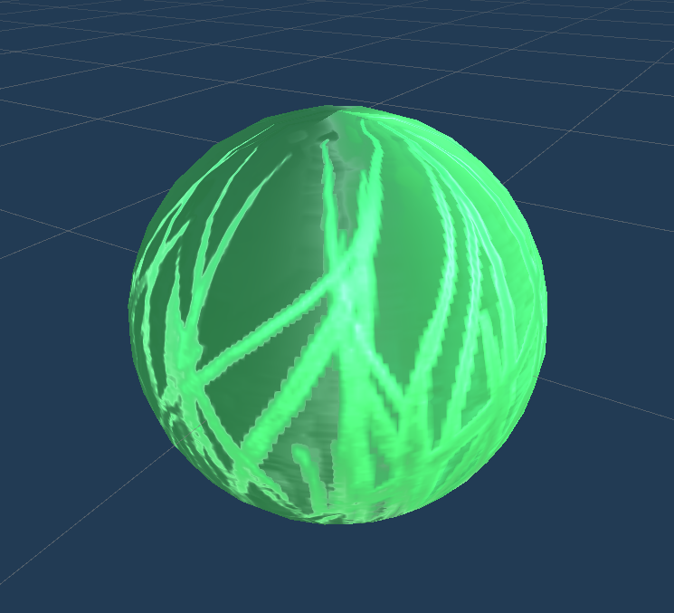
Buffs
Yellow Buff: Speed Buff for the Paddle
Blue Buff: Spawns an extra Ball
Red Buff: Length upgrade for the paddle
Green Buff: Erases Yellow and Red Buffs from the Paddle

Slide 10
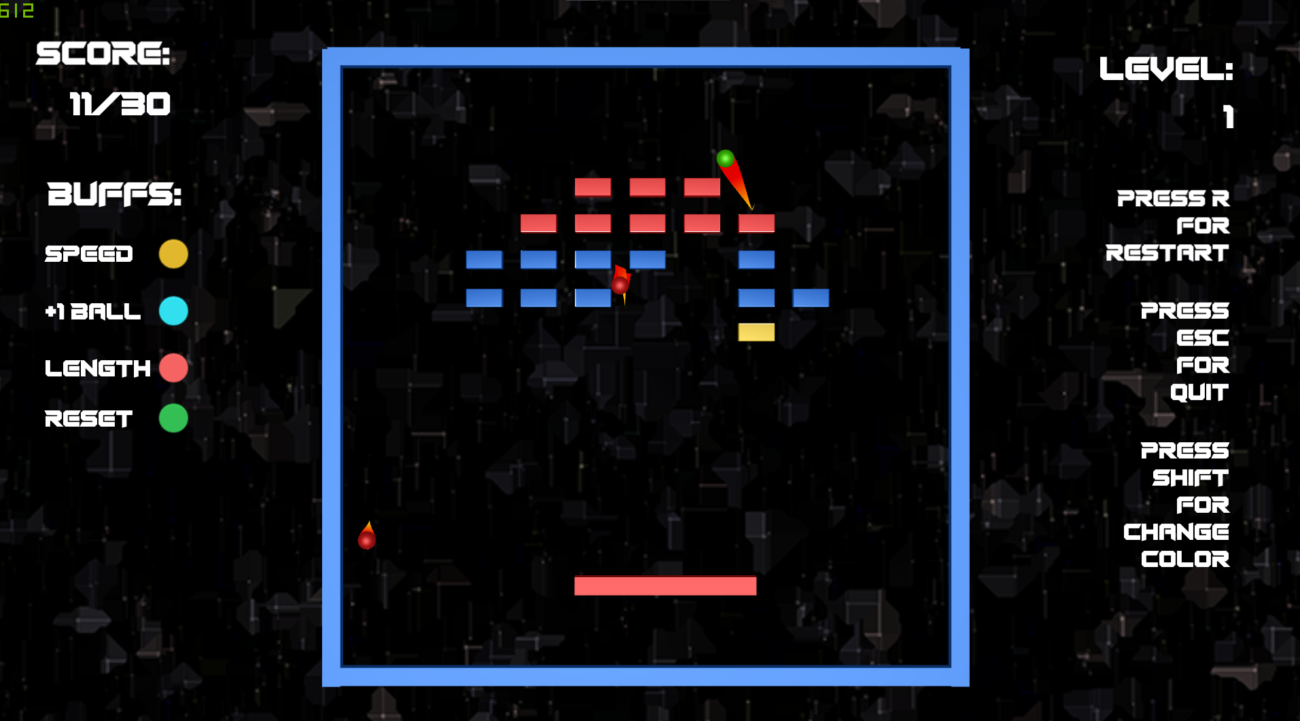
What’s Extra for hardcore gamers?
I created an extra mode after Shape and Classic mode which is Color mode.
In color mode you play the game as classic game but the twist is you can only destroy objects with same as your ball’s color.
You can change your ball’s color with Shift key

Slide 11
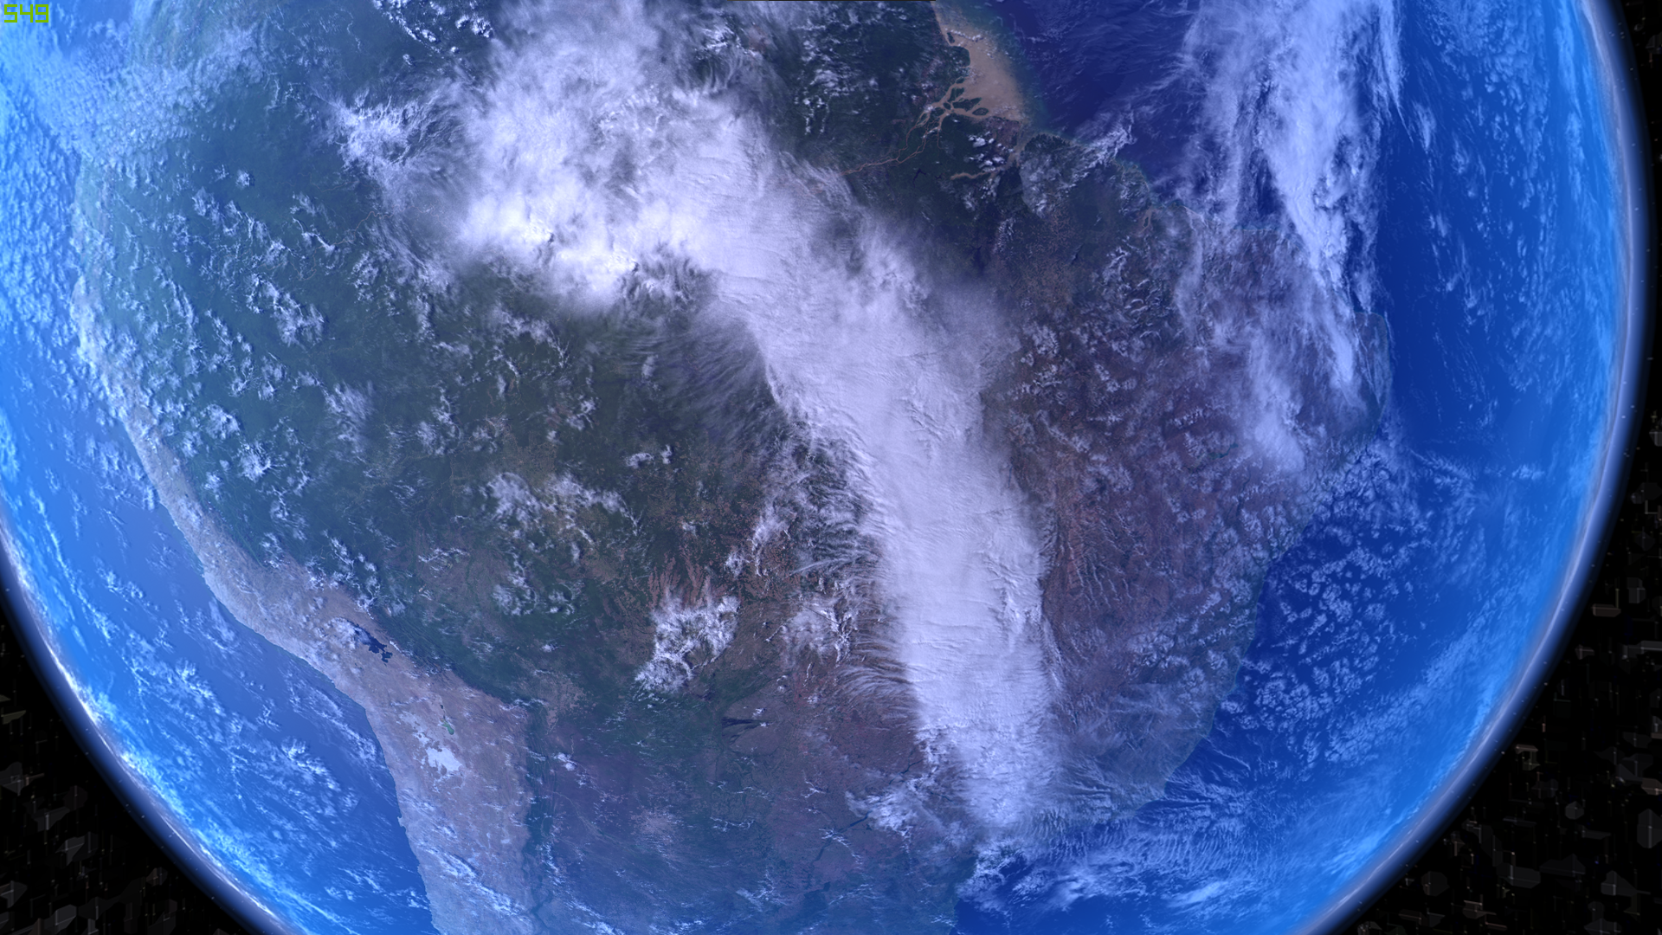
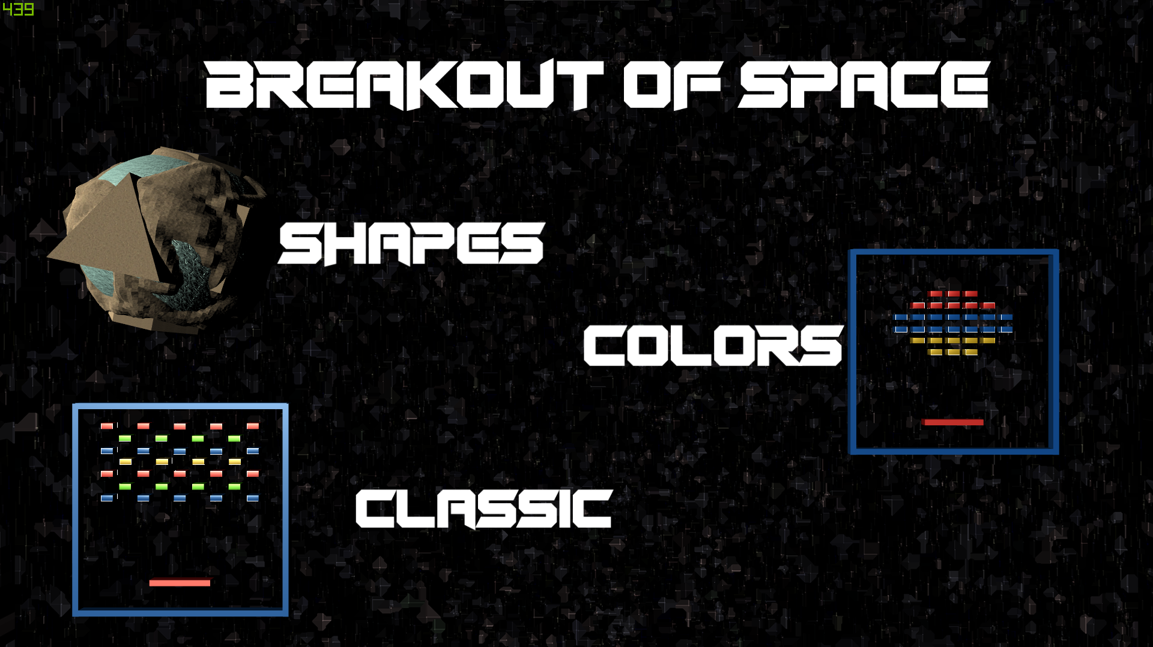
Every game needs maın menu
- So ı created a menu wıth anımatıons starts wıth lookıng to earth and turnıng back to games

Slide 12

Thank You
Mustafa Candan
21627059
Breakout from space

